Slide 1



MCCDEC/MCCCARE/CCS
Data Workshop
August 1, 2016
Predictive Analytics Panel
Steve Sparling Westshore Community College
Robert Marsh North Central Michigan College
Jamie DeLeeuw Monroe County Community College
Danielle Barnes Lansing Community College

Slide 2

SPSS Modeler – Proof of Concept
IR
Analytic Scope: Using our 2013 FTIAC population, develop a model that will predict student persistence.
Key definition:
  Student Persistence – Student graduates or is enrolled in 4 of 6 semesters.
Analytic results are part of a larger process; inform intervention strategies.
  Evaluation Criteria
  Predict persistence with >= 70% accuracy
  Individual student to risk factors
  Minimal administrative burden (i.e. IT Support)
  Repeatable/Understandable process & results
  Multi-purpose
  Economical
“All Models are wrong, but some are useful!”
George E. P. Box

Slide 3
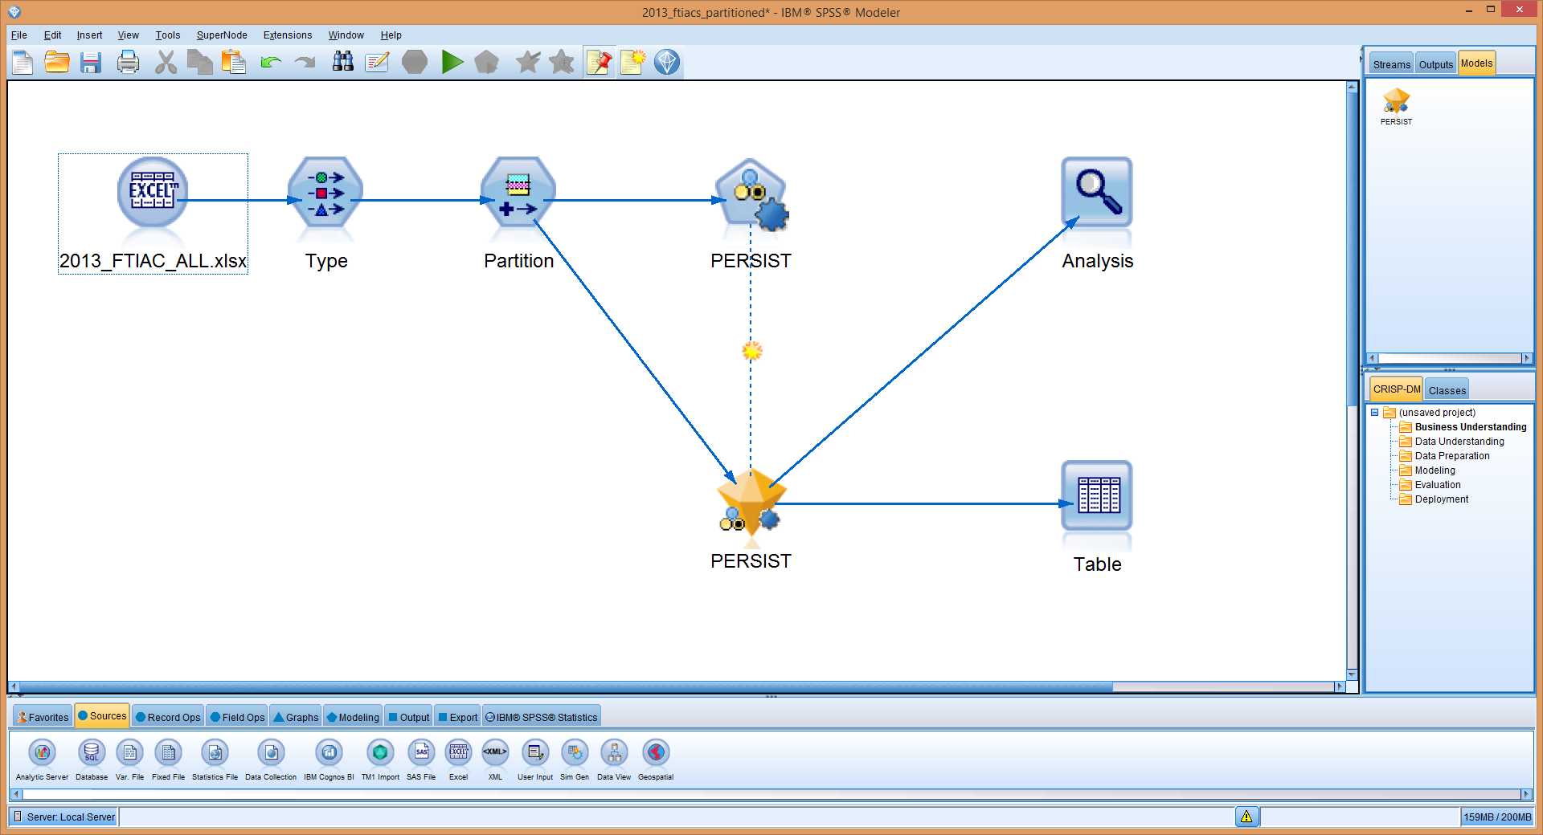
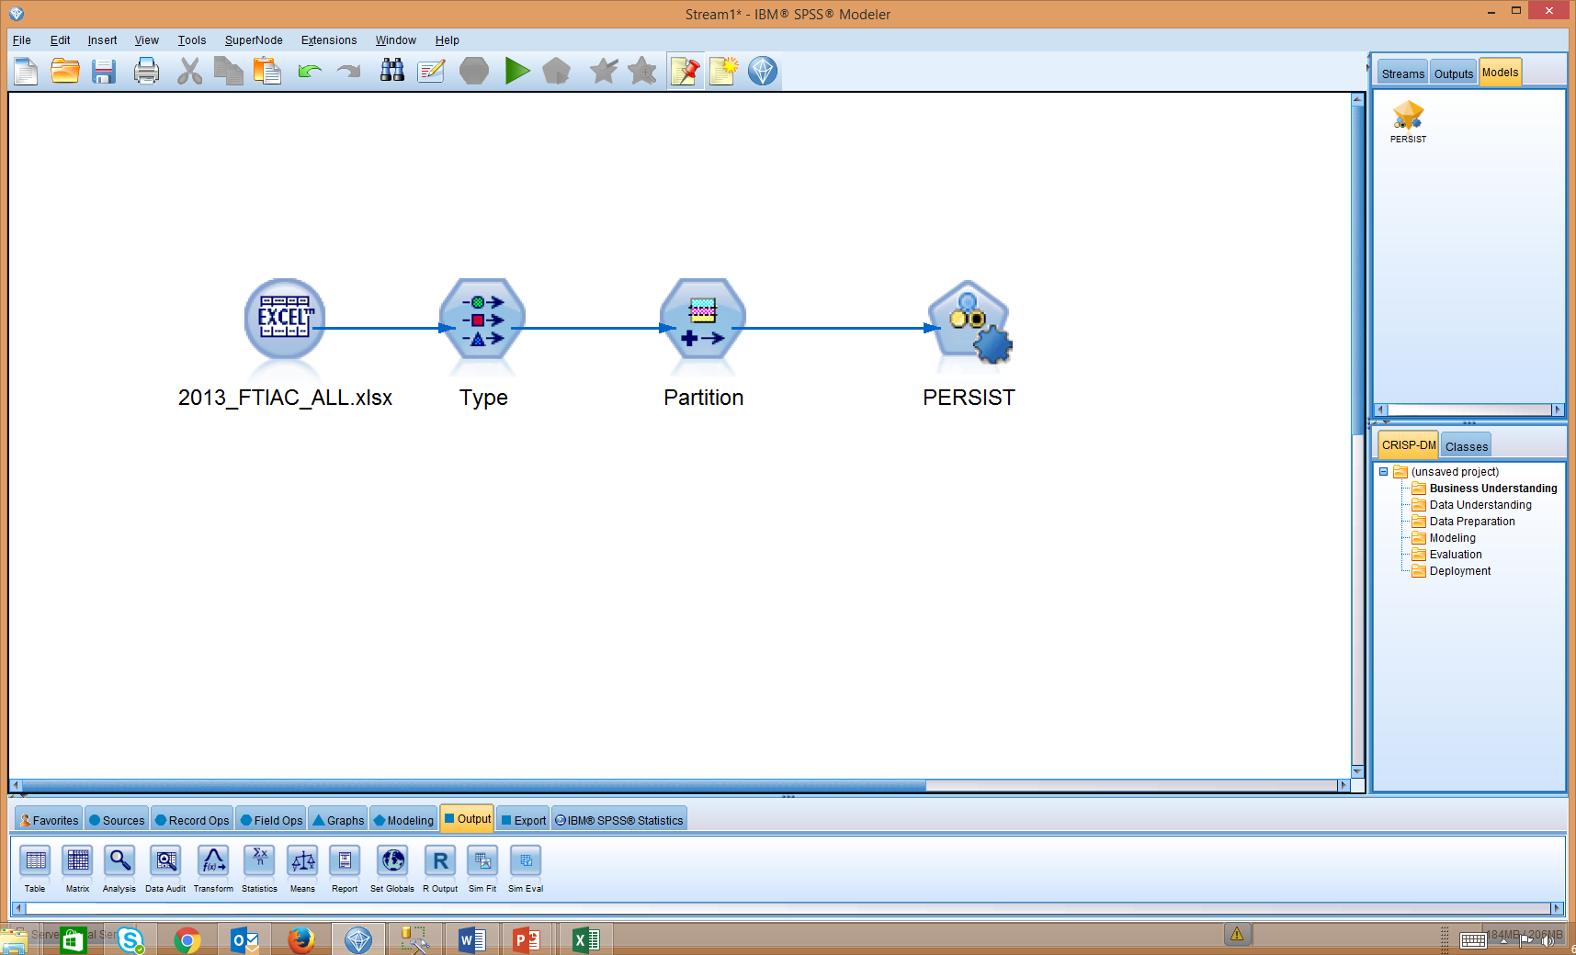
Basic “Stream” of Persistence Model
Import Student Data
Declare inputs
Divide data into two groups:
Training / Test
Identify “best fit” model

Slide 4
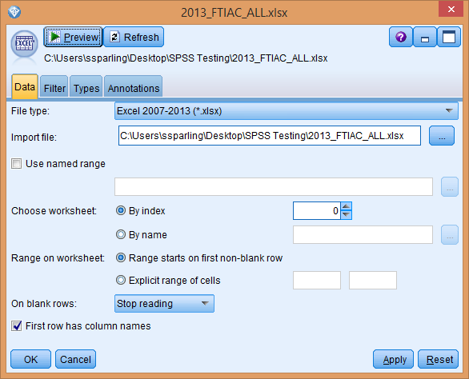

Slide 5
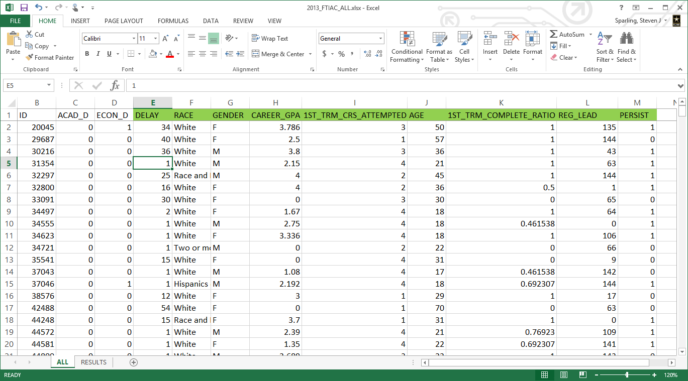

Slide 6
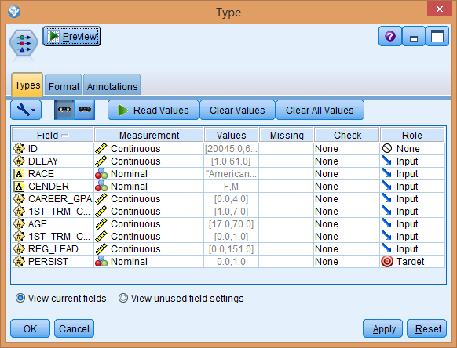

Slide 7
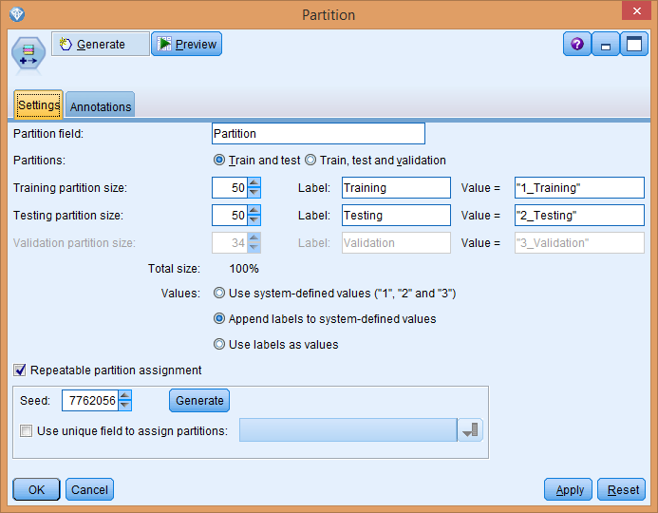

Slide 8
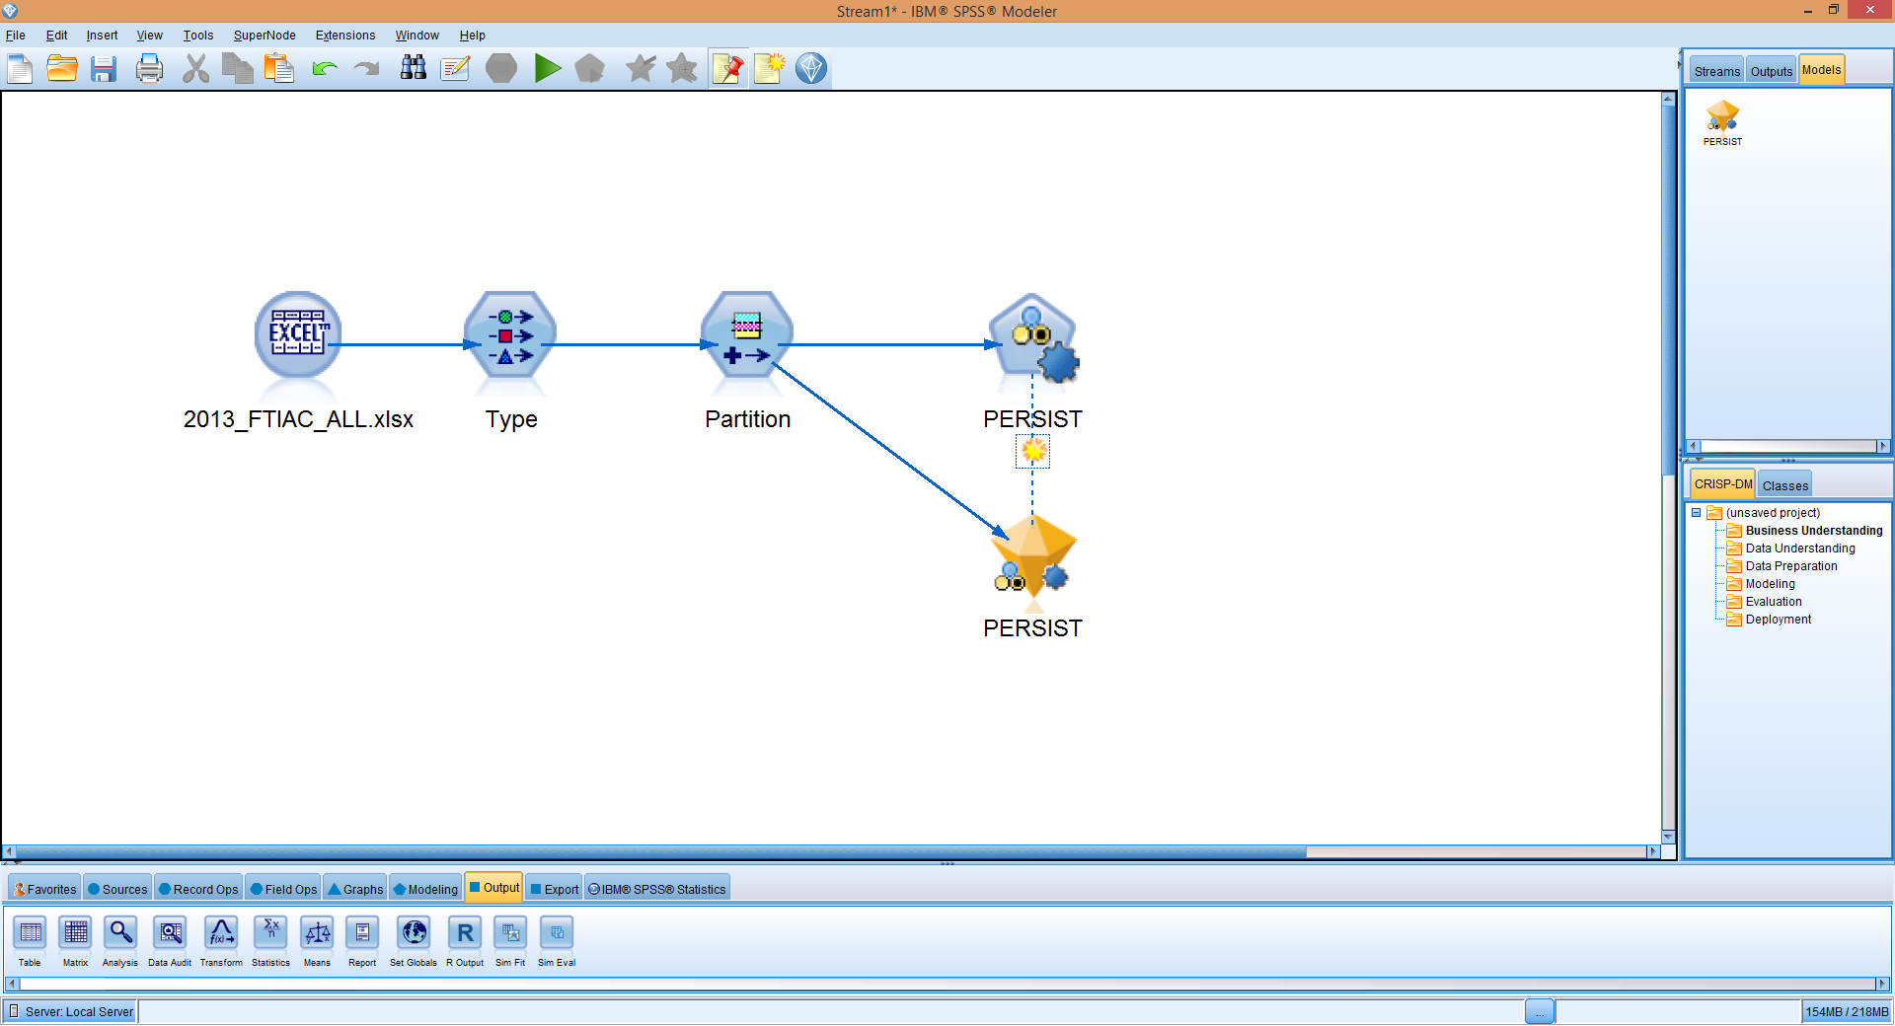
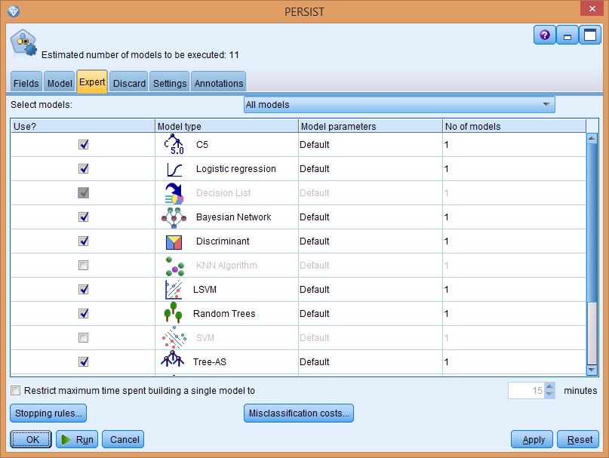

Slide 9
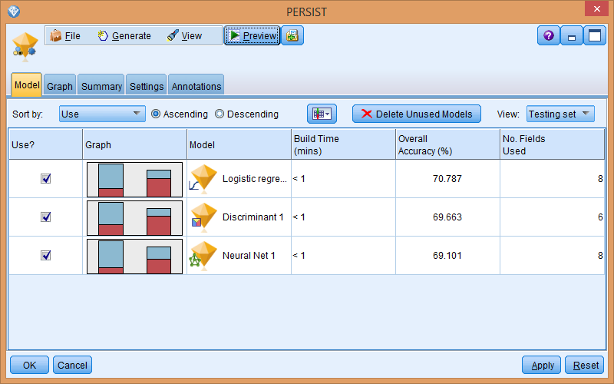

Slide 11
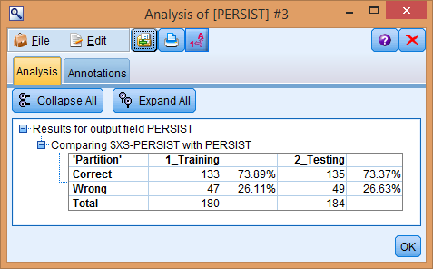

Slide 12
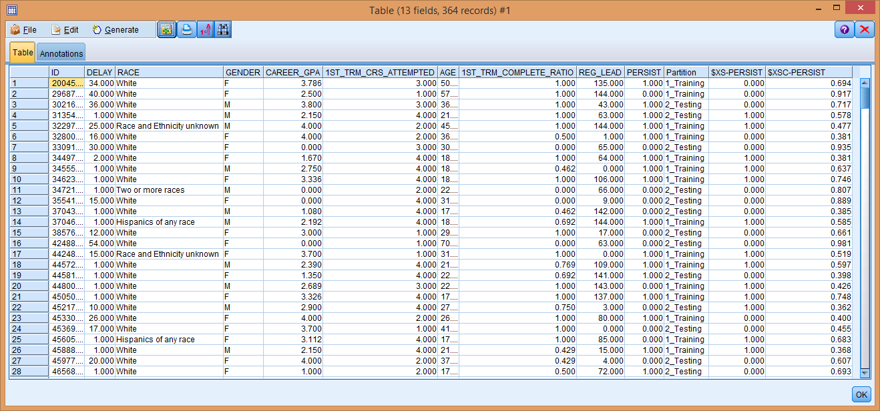

Slide 13
Alternatives Considered
IR
SPSS Modeler
  Predict persistence with >= 70% accuracy
  Individual student to risk factors
  Minimal administrative burden (i.e. IT Support)
  Repeatable results
  Multi-purpose
  Economical
CIVITAS (1)
Predictive Analytic Reporting Framework (PAR) (1,2,4,6?)
Dropout Detective (2,4,6?)
Starfish Early Alert (2,4,6?)
Tableau (4,5,6)

Slide 14

Using Time Series Modeling to Forecast Enrollments
Robert J. Marsh, Ph.D.
Associate Dean of Research and Assessment
North Central Michigan College

Slide 15
Previous forecasts
Intuitive, sense of potential population
  Trends in HS graduations
  Conversations with HS counselors
  Conversations with workforce organizations and advisory boards
Assume flat enrollment for budget; be pleased with an increase
Assume a 2-3% year-over-year increase
  Held steady for many years
Extrapolate from recent terms’ trend
Monitor statewide trends among CCs
No data-informed methodology

Slide 16
Time series forecasting
Relies on past demand to forecast future
Stores only one past period’s demand (originally necessary)
Typically forecasts one period ahead

Slide 17
Time series forecasting
Simple: forecast = immediate past period
Moving average: average of n past periods

Slide 18
Exponential Smoothing
Originated in the production/operations management field, 50+ years ago (management science)
Primary formula
where α is the “smoothing coefficient”
Relies on the past period’s actual (A_{t-1}) and forecast (F_{t-1}) values.
An α close to 1.0 results in a very reactive model, one more responsive to very recent actual data.
All that needed to be stored were the immediate past actual and forecast values.
(Holt, 1957)

Slide 19
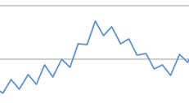
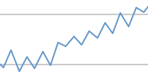
Adding trends and/or seasonality
Trends within our actual enrollment patterns.
  Add a trend component
Enrollment is seasonal, with fall typically being higher than winter
  Add seasonality component by superimposing a sinusoidal function
  Exclude summers (much lower)
Fall
Winter

Slide 20
Methodology
Obtained 30 years of enrollment data (credit hours)
  60 periods (no summers- too small)
Built model in Excel® 2016
  Used Solver® to “optimize” the model
Minimized sum of squared differences (the objective function, Z)
  by varying α, β, H, ν and φ
  (β, H, ν and φ are from trend and seasonality components)

Slide 21
Results and calculations
Year | YrTm | Actual | Smooth F | Smooth T | Seasonality | FORECAST | Squared Diff
2014 | 201430 | 20177 | 20132 | -435.19 | -1114.98 | 20066 | 12225.0
2014 | 201450 | 18782 | 18816 | -783.53 | 1109.58 | 18582 | 40144.4
2015 | 201530 | 20023 | 19950 | -25.26 | -1104.19 | 19142 | 776823.4
2015 | 201550 | 18405 | 18461 | -604.03 | 1098.79 | 18820 | 172615.6
2016 | 201630 |  |  |  |  | 18956
 |  |  |  |  |  | Z = | 35996906.6
Parameters
α | β | Η | ν | φ
0.963 | 0.395 | 8360.753 | 1.000 | 2.965

Slide 22
Model fit, by semester

Slide 23
Model fit, by year

Slide 24
Discussion
Model is not optimal
  Non linear objective function; heuristic methodology
Does not include any outside variables
Solver® is blunt instrument (for non-linear functions)
Can be built on simple software platform
Good visualization with graphs
Relies on known data
Very quick to update
Reasonably accurate

Slide 25

ARIMA Time-Series Modeling: Do Tuition and/or Unemployment Rate Predict Enrollment?
Jamie DeLeeuw, Ph.D.
Coordinator of Research, Evaluation, & Assessment
Monroe County Community College

Slide 26
Limitations to Prior Research:
Gallet’s (2007) Meta-Analysis
A majority (72.5%) of tuition analyses use ordinary least squares (OLS). This method is problematic in that OLS assumes homoscedasticity and lack of autocorrelation in the residuals (Tabachnick & Fidell, 2007).
Regardless of the procedure used, analyses have tended to cover the short-run (91%) and correction for autocorrelation (28%), heteroscedasticity (7%), and multicollinearity (11%) has been rare.
In studies that include adjustments for autocorrelation and heteroscedasticity, enrollment is less affected by tuition increases.
______________________________________________
Previous research tends to conglomerate data from multiple institutions and assesses Fall (typically full-time) headcount fluctuations over a limited time span.

Slide 27
ARIMA
Autoregressive Integrated Moving Average (ARIMA) time-series analysis is an ideal way to examine enrollment patterns over time, test whether variables serve as predictors, and forecast future enrollment, while avoiding the aforementioned statistical blunders.
A model (p, d, q)(P, D, Q) is selected that best characterizes patterns in the data:
p = auto-regression
d = integrated (linear or quadratic trend)…differencing or transformation?
q = moving average (random shocks)

Slide 28
Goodness-of-Fit
Ljung-Box statistic: Whether model is correctly specified; desire > .05
Stationary R²: Estimate of the proportion of the total variation in the series that is explained by the model; more appropriate than ordinary R² when there is trend or a seasonal pattern
Model outliers?
Are predictors statistically significant?
Graphs
ARIMA Expert Modeler vs. playing around

Slide 29
Getting the Data Ready
Tuition: Credit hour + technology fee
  U.S. Inflation Calculator (converted $ to 2011)
County Unemployment Rate:
  http://data.bls.gov/map/MapToolServlet?survey=la
50+ data points
Enrollment (DV): Billable contact hour
  Credit to contact hour conversion if needed
Define dates
Reminder: If your model contains significant predictors, those need to be forecasted or entered before forecasting the DV(enrollment)

Slide 30
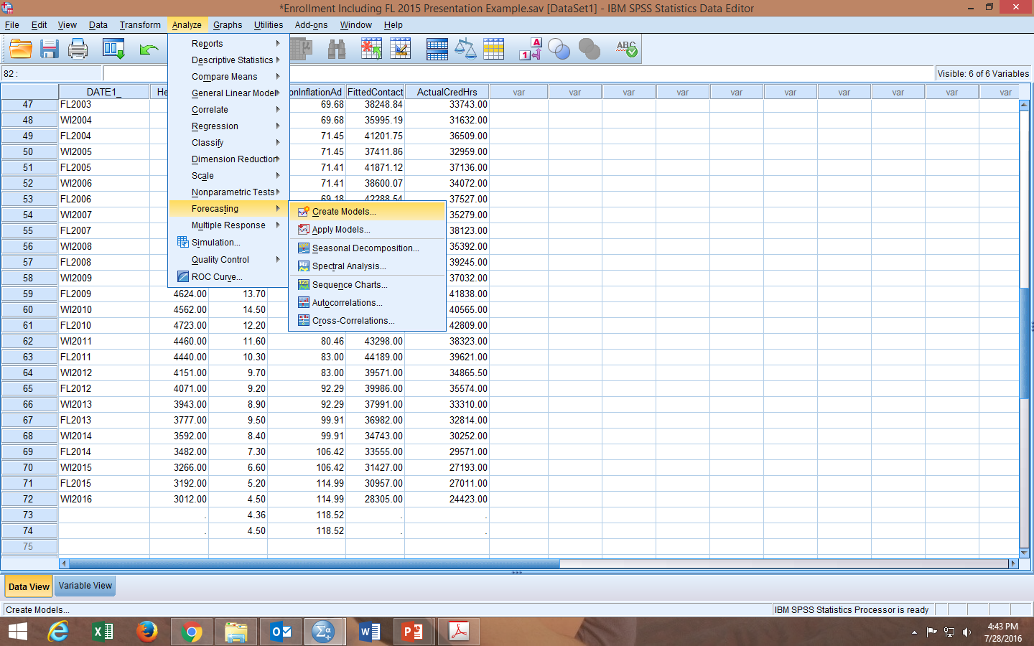

Slide 31
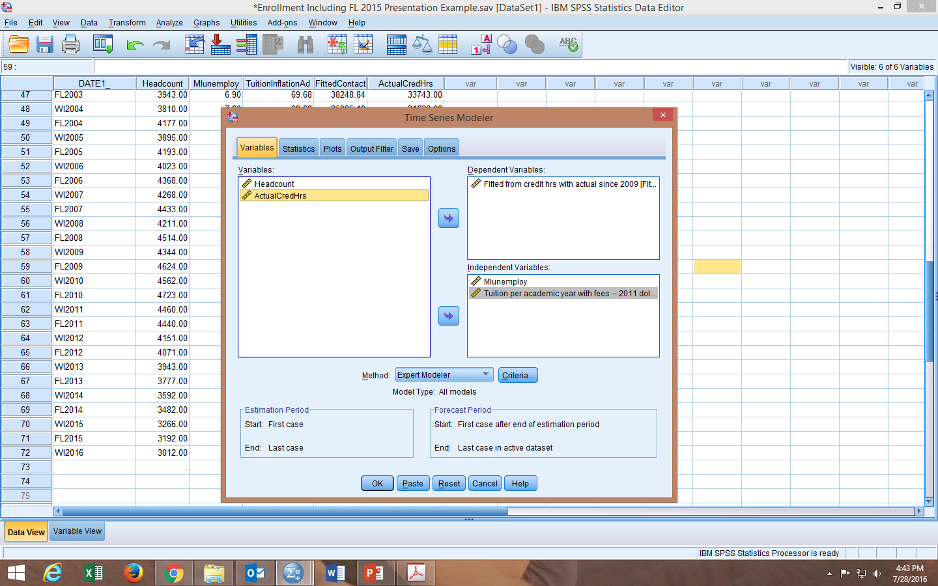

Slide 32
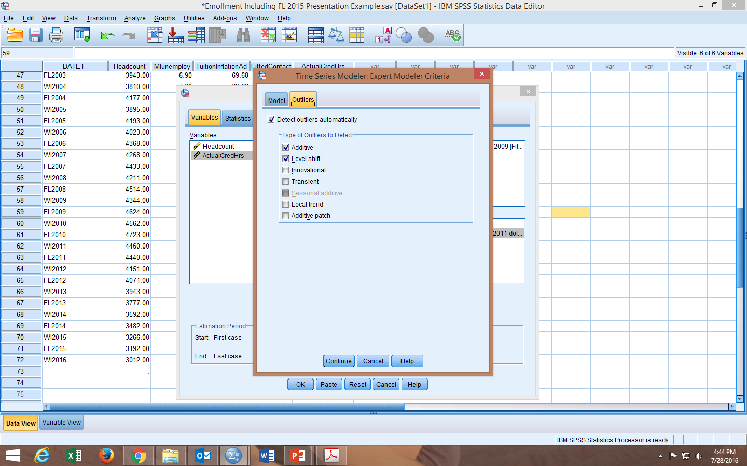

Slide 33
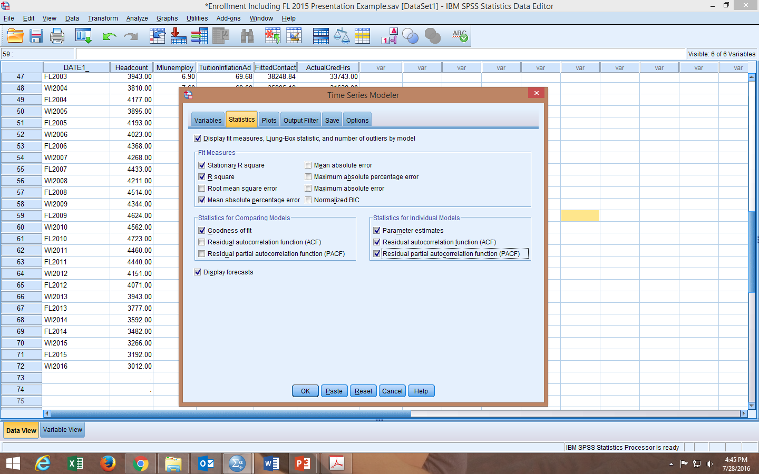

Slide 34
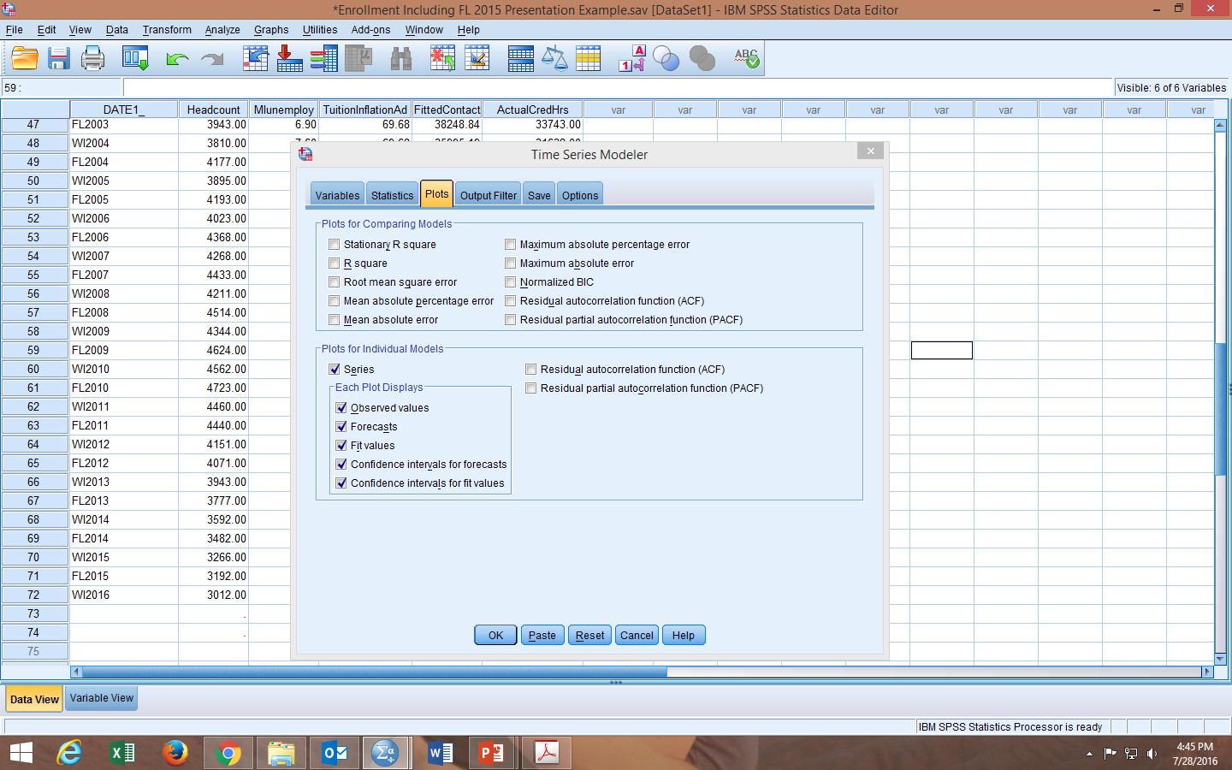

Slide 35
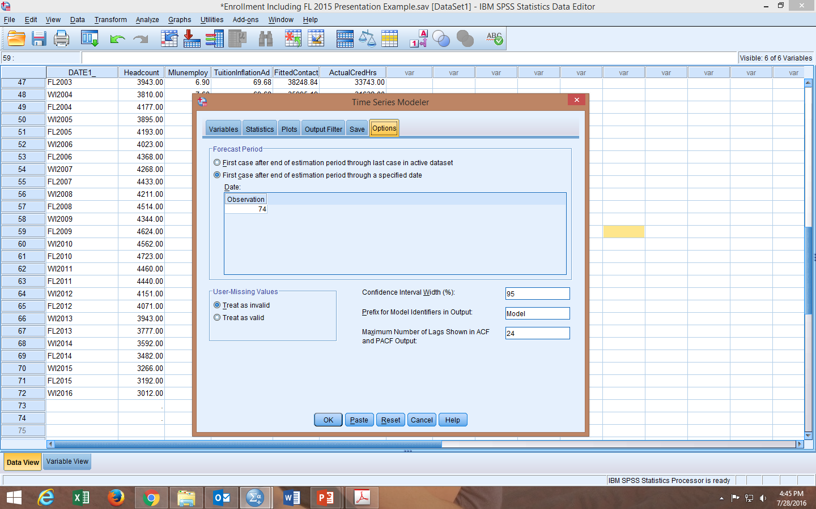

Slide 36
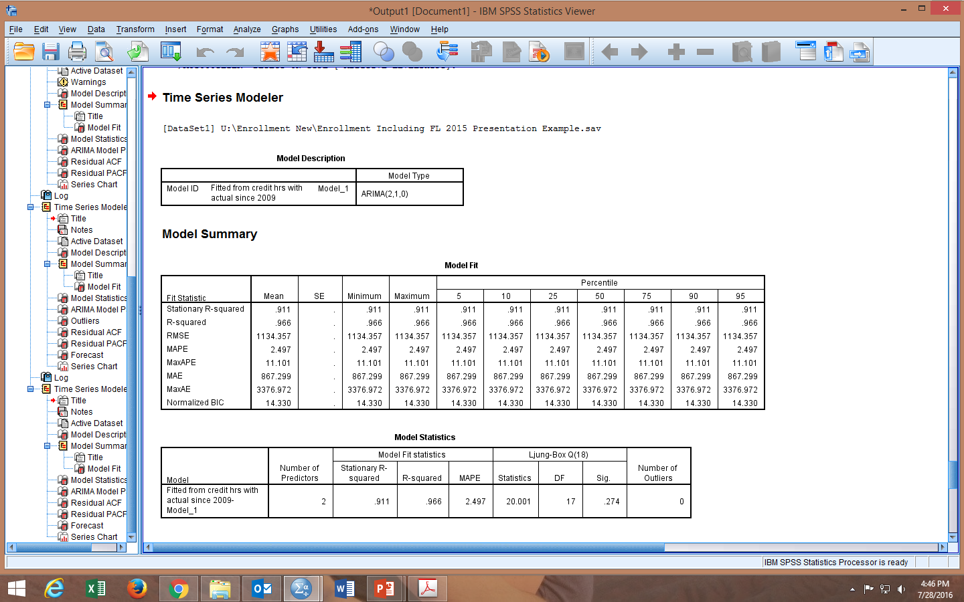

Slide 37
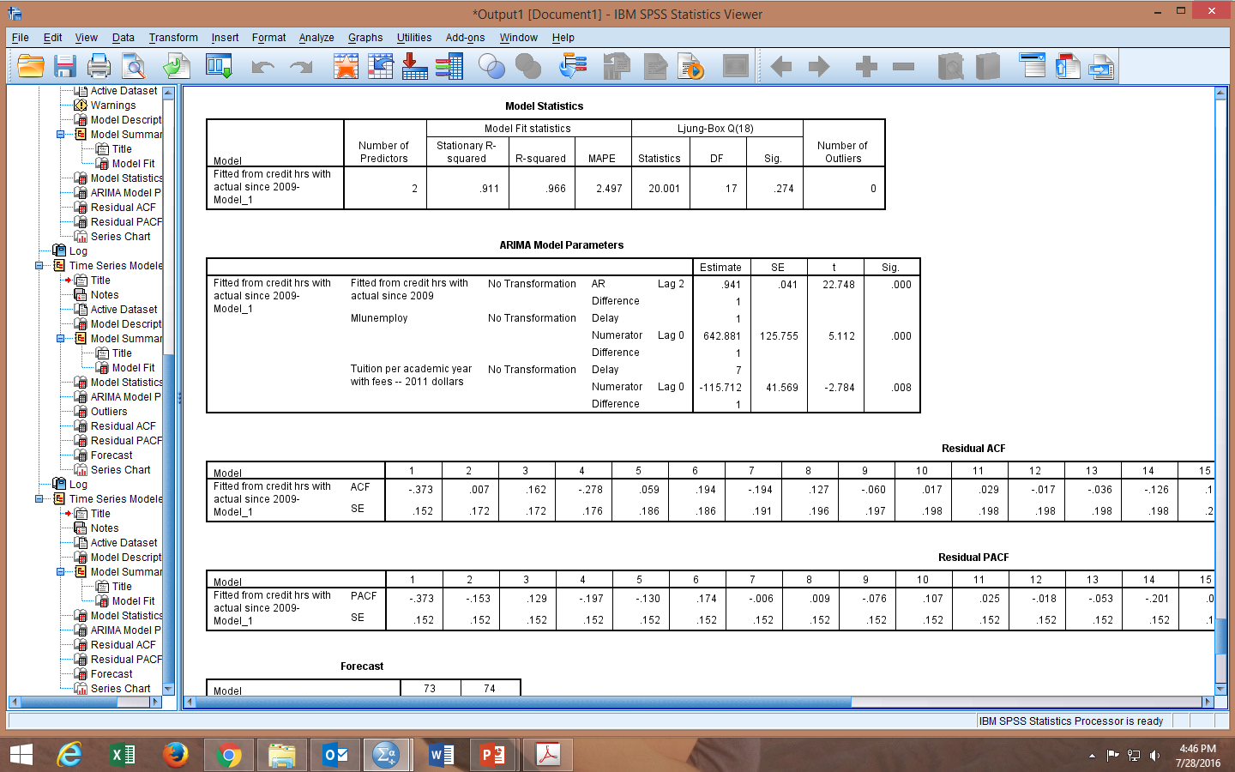

Slide 38
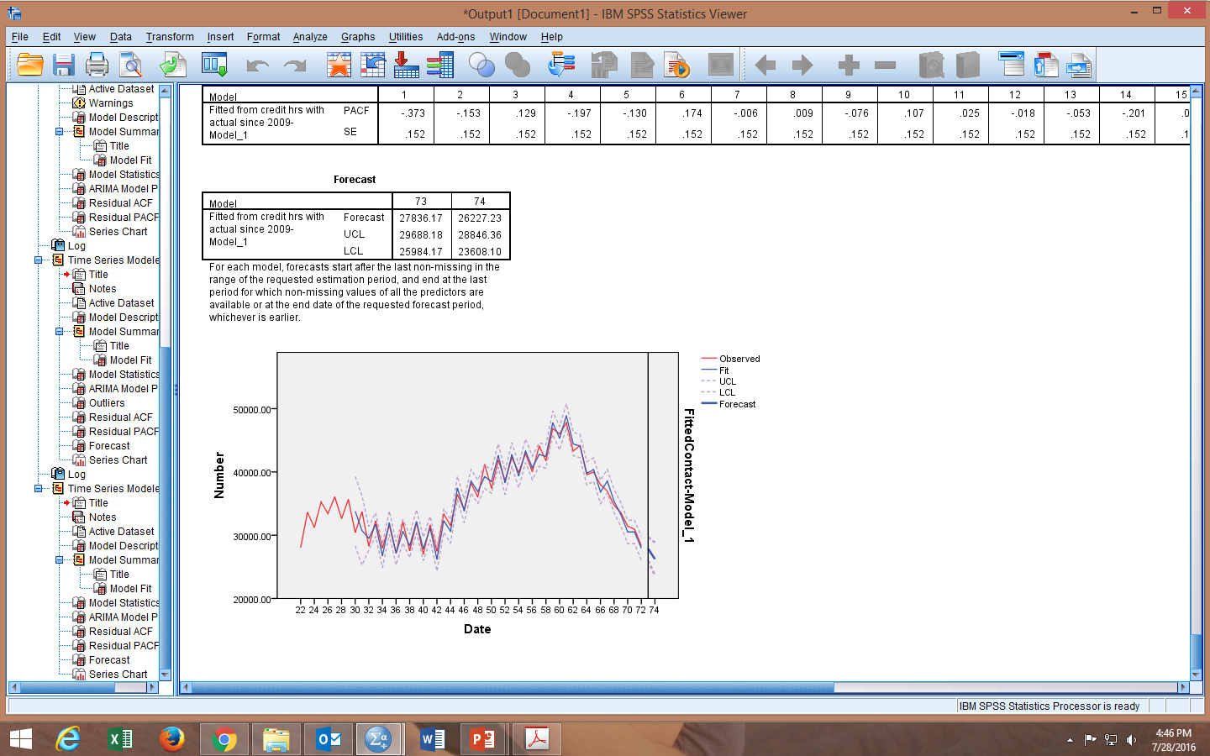

Slide 39
Results
Using data from Fall 1980 to Winter 2016 , 91.1% of the total variation in billable contact hours was captured by the model. Both county unemployment rate and tuition served as enrollment predictors. We can be 95% confident that Fall 2016 contact hour enrollment will lie somewhere between 25984 and 29688, with the best estimate being 27836. It is important that new data be added each semester to capture recent policy changes and trends, thereby increasing the accuracy of the forecast.

Slide 40

Enrollment Forecasting using
ARIMA
Danielle Barnes
Predictive Analyst
Lansing Community College

Slide 41
OVERVIEW
What is Enrollment Forecasting?
Enrollment Forecasting can be any number of methods to “predict” various measures related to enrollment for an institution
  Lansing Community College uses a forecasting model that predicts credit hours
Many types of modeling techniques can be used with multiple independent variables
  Lansing Community College uses a type of forecasting model called Autoregressive Integrated Moving Average Model (ARIMA). We chose not to use any independent variables.
    This was a great choice over other models due to the fact we would not need to forecast unemployment for model use
Notes:
For the Fall 2014 – Summer 2015 year, the model has over predicted by 3%.

Slide 42
ARIMA MODEL PROCEDURES
Plot and examine your data. Do you notice any long term trends or seasonal variation? If so, a differencing term is appropriate.
Plot your data against lagged values. Do you see any evidence of autocorrelation? If so, autoregressive and/or moving average terms may be appropriate.
Determine an initial model, test for variable significance, and rank based on chosen comparative criterion.
Notes:
Autocorrelation – plot data against past values of itself. Do you see a linear relationship?
Autoregressive and Moving Average terms use past data and past errors to estimate future values

Slide 43
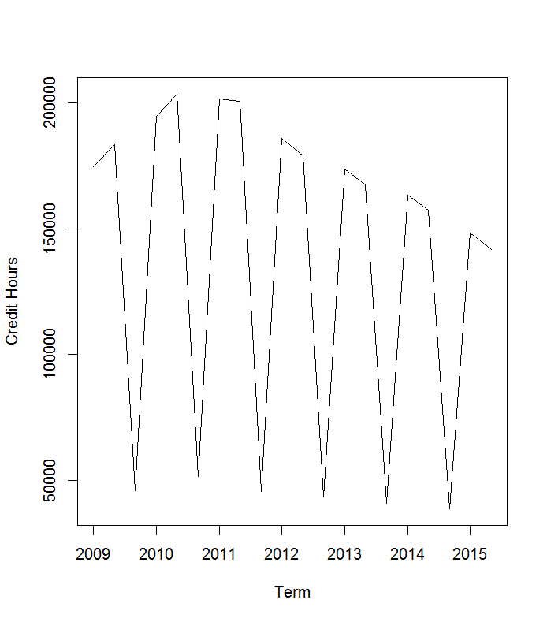
EXAMPLE
Plot and examine your data. Do you notice any long term trends or seasonal variation? If so, a differencing term is appropriate.
We have plotted credit hours against the term. We note a strong seasonal trend. This indicates a seasonal differencing term would be appropriate.
Notes:
If there were no seasonal trend, we would not see the peaks and valleys in a predictable pattern.

Slide 44
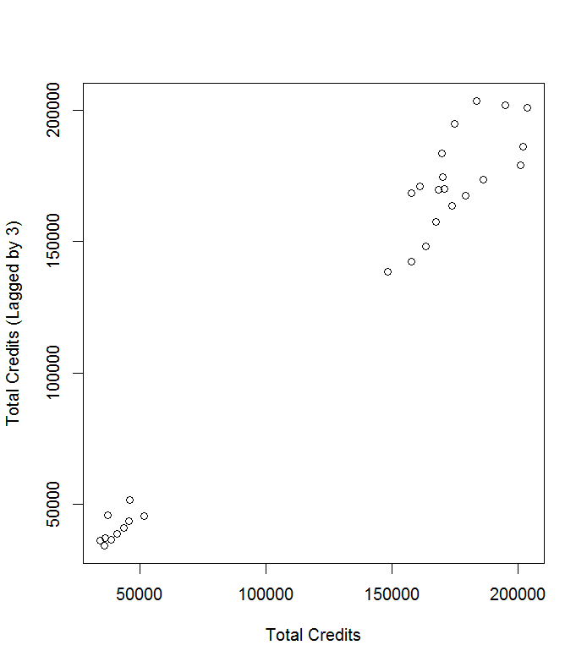
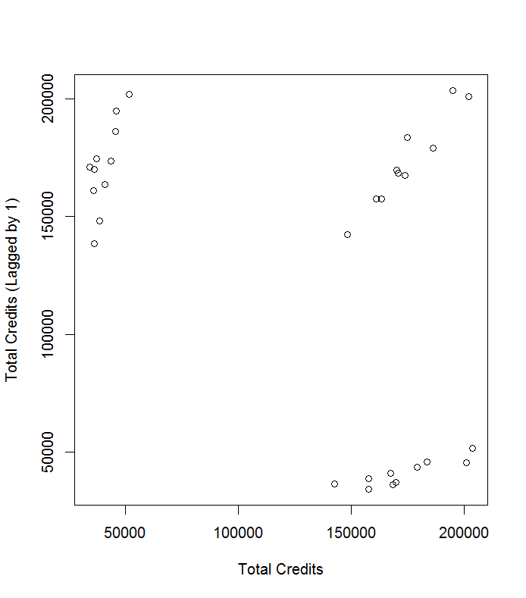
EXAMPLE
Plot your data against lagged values. Do you see any evidence of autocorrelation? If so, autoregressive and/or moving average terms may be appropriate.
We have plotted credit hours against themselves with a lag of 3 (due to seasonality), and see a strong autocorrelation. Due to this observation, we want to include an autoregressive and/or moving average term in our model.
Notes:
We chose a lag of 3 since our data is composed of three terms.

Slide 45
EXAMPLE
Non-Seasonal | Seasonal | AIC | AR1 P Value | AR2 P Value | MA1 P Value | MA2 P Value | SAR1 P Value | SMA1 P Value | Intercept
1,1,1 | 0,1,1 | 578.15 | 0.018 |  | 5.60E-09 |  |  | 1.27E-01
1,1,0 | 0,1,1 | 579.24 | 0.187 |  |  |  |  | 0.593
1,1,1 | 1, 1, 1 | 580.12 | 0.024 |  | 1.30E-05 |  | 0.868977 | 0.0555
0,1,0 | 0,1,0 | 587.81
1,1,1 | 0,1,0 | 588.63 | 0.944 |  | 4.90E-01
1,0,0 | 0,1,1 | 595.03 | 3.20E-05 |  |  |  |  | 3.80E-02
2,0,1 | 0,1,1 | 598.34 | 0 | 3.73E-05 | 0 |  |  | 1.36E-02
1,0,0 | 1,0,1 | 674.74 | 0.0001 |  |  |  | 0 | 2.42E-01 | 0.1926
1,0,1 | 1,0,1 | 676.73 | 0.026 |  | 9.26E-01 |  | 0 | 1.75E-01 | 0.195
2,0,2 | 1,0,1 | 677.66 | 0 | 1.62E-12 | 5.85E-10 | 0.00E+00 | 0 | 8.00E-04 | 4.40E-02
1,0,0 | 1,0,0 | 686.46 | 1.34E-06 |  |  |  | 0 |  | 0.336
1,1,1 | 0,0,1 | 747.06 | 0.018 |  | 1.14E-12 |  |  | 4.28E-13
0,0,1 | 0,0,1 | 763.06 |  |  | 1.95E-05 |  |  | 7.07E-13 | 0
1,0,1 | 0,0,1 | 764.26 | 0.3329 |  | 0.016 |  |  | 7.50E-13 | 0
1,0,0 | 0,0,1 | 766.71 | 0.011 |  |  |  |  | 4.28E-13 | 0
Determine an initial model, test for variable significance, and rank based on chosen comparative criterion.
Using various models, we compare variable significance and use AIC to compare models.
Notes:
AIC gives us a measure of the goodness of fit, and simplicity of the model. We want to choose the lowest AIC.
Keshvani, Abbas (2013) Using AIC to Test ARIMA Models https://coolstatsblog.com/2013/08/14/using-aic-to-test-arima-models-2/ Accessed on 7/28/2016

Slide 46
MODEL PERFORMANCE
Notes:
For the Fall 2014 – Summer 2015 year, the model has over predicted by 3%.

Slide 47
CONTACT INFORMATION
A Data Template and Code is available. Please contact Danielle Barnes.
Phone: 517.483.1506
Email: barne61@lcc.edu

Slide 48
ARIMA CONCEPTS
Stationary: No predictable trend patterns (model assumption)
Seasonality: No predictable patterns based on season
Autoregressive: Future values of the variable are dependent on past values of the variable
Differences: Compute the changes in observations (this can be seasonal or non-seasonal)
Moving Average: Future values of the variable are dependent on past forecast errors
Akaike Information Criterion (AIC): A way to compare different models – we look for the minimum value
Hyndman, R.J. and Athanasopoulos, G. (2013) Forecasting: principles and practice. OTexts: Melbourne, Australia. https://www.otexts.org/fpp. Accessed on 7/27/2016.

Slide 49
ARIMA MODEL OVERVIEW
A seasonal ARIMA model is typically designated with the following notation:
ARIMA (p, d, q) x (P, D, Q)
where p, d, q are the non-seasonal terms and P, D, Q are the seasonal terms and
p, P: Autoregressive Terms
d, D: Difference Terms
q,Q: Moving Average Terms
An ARIMA (1, 0, 0) x (0, 1, 1) model would be a model that includes a non-seasonal autoregressive term, a seasonal differencing term, and a seasonal moving average term.
Nau, Robert (2016) Statistical forecasting: notes on regression and time series analysis http://people.duke.edu/~rnau/411home.htm Accessed on 7/27/2016

Slide 50
Thank you!
Questions?
Contacts:
Danielle Barnes Lansing Community College barne61@lcc.edu
Jamie DeLeeuw Monroe County Community College jdeleeuw@monroeccc.edu
Bob Marsh North Central Michigan College rmarsh@ncmich.edu
Steve Sparling Westshore Community College ssparling@westshore.edu

